Slide 1

Problem Statement and Background
Team’s purpose
Our project looks at Reddit comments to analyze audience emotions and interaction with the Christmas film Red One. Through the analysis of user comments, we aim to learn how viewers interpret the film, whether their responses are positive, neutral, or negative, and which elements—like the plot, the actors, the action scenes, or the holiday themes—are most often brought up. This study will provide light on the elements that influence audiences' perceptions of Red One and how effectively it connects with them.
Imperatives and objectives
Evaluate Audience Reactions: For an idea of the general reception, group comments into positive, neutral, or negative.
Determine the Main Topics of Discussion: Find out and extract what the audience is discussing, such as the plot, the actors, the action scenes, or the holiday themes.
Measure Engagement: Examine the relationship between audience sentiment and the number of upvotes the comment receives to understand audience interaction.

Slide 2
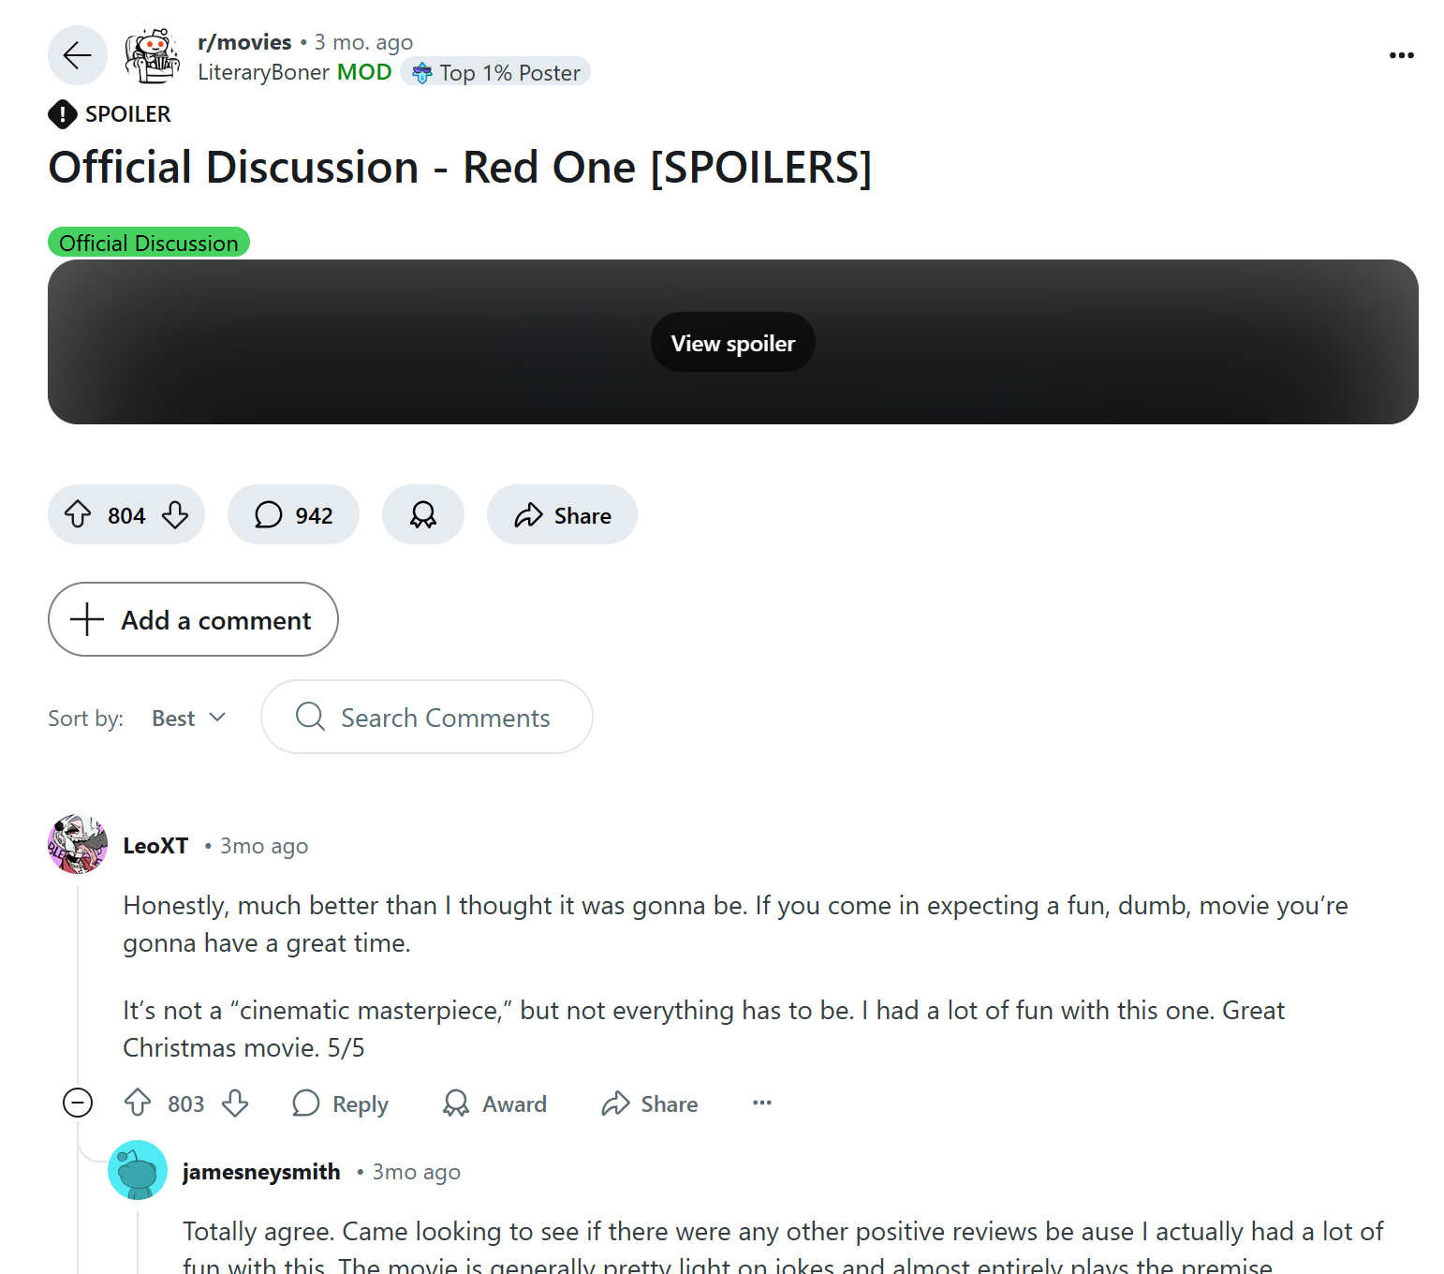
Data Understanding
Process of acquiring our dataset
Using the Reddit API and PRAW, the dataset was obtained from the Reddit r/movies subreddit. All of the user comments that were available were retrieved from a Red One review thread through a script. Vader was used to assign sentiment scores, classifying each comment as either positive, neutral, or negative. After that, the data was organized for analysis using a Pandas DataFrame.
Our dataset
The dataset includes 951 Reddit comments about Red One from the Reddit movie subreddit. Post ID, subreddit name, comment text, upvotes (the amount of engagement), and a sentiment score (Positive, Neutral, or Negative) are all included in each comment to assess audience perspective.
Why our dataset can address our problem statement
The dataset uses sentiment ratings to determine whether responses are positive, neutral, or negative to capture the actual audience's opinions about Red One. Discussion themes are revealed through comment text, while audience perception and responses are analyzed by upvotes, which show engagement trends.
Limitations or challenges associated with accessing/acquiring the data
The dataset may not accurately reflect all audiences because it is restricted to Reddit discussions. Sarcasm can be misinterpreted by sentiment analysis, and upvotes don't always mean that people agree. Additionally, only publicly accessible posts at the time of extraction are included in the data.

Slide 3
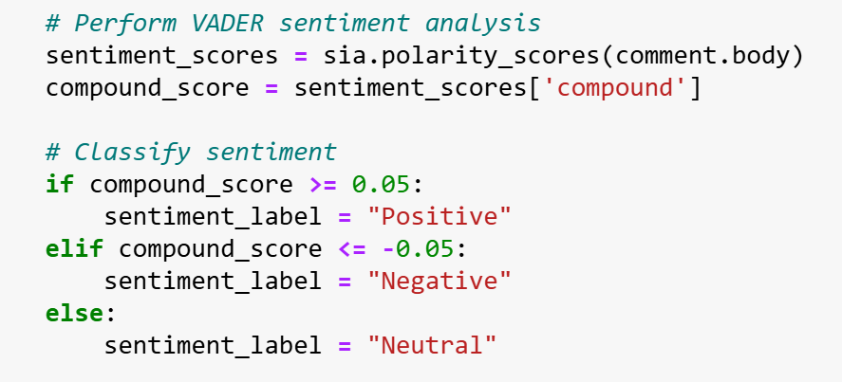
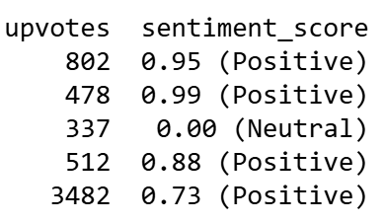
Methodology
Steps for conducting social media analytics
1. Import the libraries: Pandas, praw, Vader for API interaction and sentiment analysis
2. Define the reddit account credentials and URL of the reddit post we chose for crawling.
3. Retrieve the crawled comments and store them in a temporary list
4. Perform sentiment analysis using Vader and assign sentiment score of ‘Positive’, ’Neutral’ or ‘Negative’ to each comment. Append each comment’s metadata (comment text, upvotes etc.) and sentiment score to a list.
5. Convert the comments data into a DataFrame and export it as a CSV file for further analysis.
How each step contributes to the solving of the problem statement.
Pandas: Required to store the data in a Dataframe and export it once the comments have been crawled.
API Access (PRAW): Allows simple retrieval of Reddit comments for analysis.
Sentiment analysis (Vader): Classifies audience sentiment which helps to evaluate Red One's general reception.
Exporting to CSV: Makes data ready for more in-depth analysis to identify themes and audience engagement

Slide 4

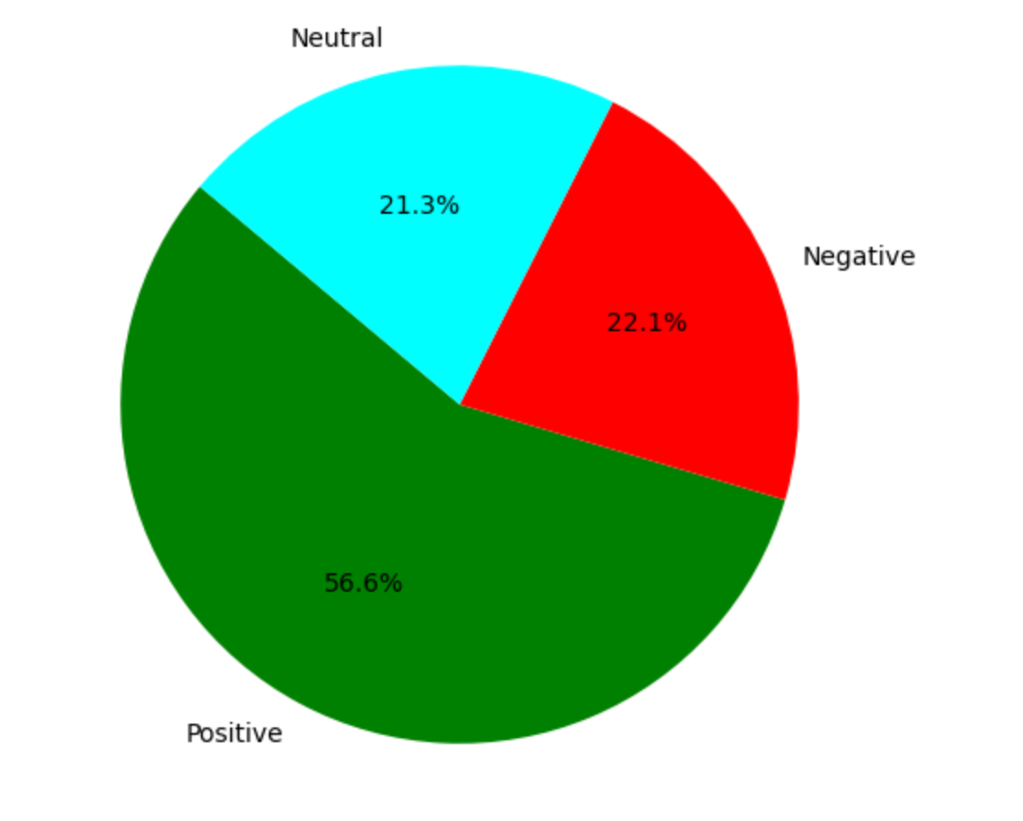
Expected Outcome
What should be the expected outcomes?
The outcomes should show a clear distribution of sentiment (positive, neutral, and negative), important discussion topics like the cast or plot, and an understanding of the relationship between sentiment and upvotes. Visuals like word clouds, pie charts, bar charts, scatter plots, and topic clusters will be useful in effectively communicating these findings.
Metrics to use to evaluate the outcomes
Sentiment Proportions: The percentage of neutral, negative, and positive comments.
Engagement Metrics: Total and average upvotes for each sentiment category.
Theme Relevance: Frequency of specific phrases or words in comments.
How to derive insights from the outcomes?
By looking at the distribution of sentiments about the movie and most frequent terms used in comments we can derive various insights about the movie and its reception by the public.
If positivity is high → The film is well-received.
If negativity is high → Look deeper at why (see bar chart & common words).
If neutral is high → Viewers may feel indifferent, meaning the movie lacks emotional impact.
If ‘CGI’ is mentioned often with disappointing negative sentiment → The effects were disappointing
If ‘plot’ is mostly neutral → The storyline might be forgettable
If "The Rock" (Dwayne Johnson) is mentioned a lot → The lead actor is a focal point for discussion.

